Slide 1
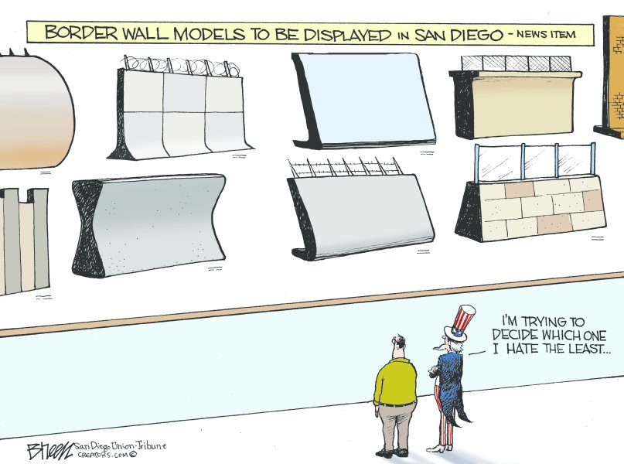
What is the primary focus of the cartoon?
Who is the intended audience?
What is the context of the cartoon?
What symbols do you see in the cartoon?
Are there additional themes?

Slide 2
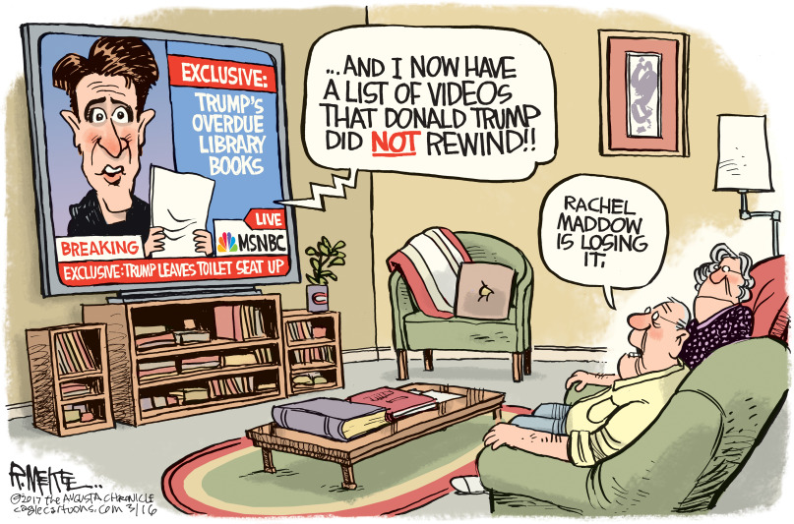
What is the primary focus of the cartoon?
Who is the intended audience?
What is the context of the cartoon?
What symbols do you see in the cartoon?
Are there additional themes?

Slide 3
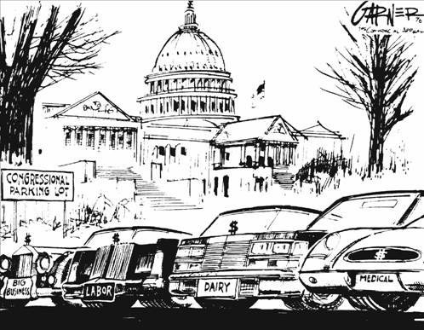
What is the primary focus of the cartoon?
Who is the intended audience?
What is the context of the cartoon?
What symbols do you see in the cartoon?
Are there additional themes?

Slide 4
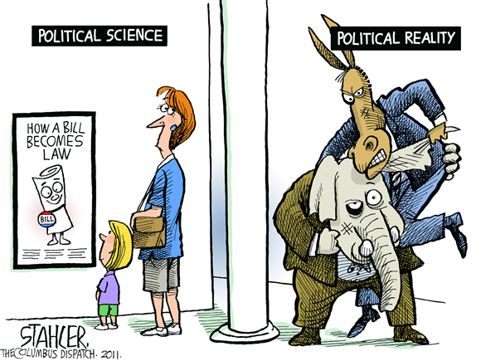
What is the primary focus of the cartoon?
Who is the intended audience?
What is the context of the cartoon?
What symbols do you see in the cartoon?
Are there additional themes?

Slide 5
ANALYZING POLITICAL CARTOONS
As you look at the political cartoons, placed around the pod, consider the questions we just answered together. On the paper provided, briefly describe the following for each of the cartoons
Primary Focus/Message
Intended Audience
Context
Symbols
Other Themes

Slide 6
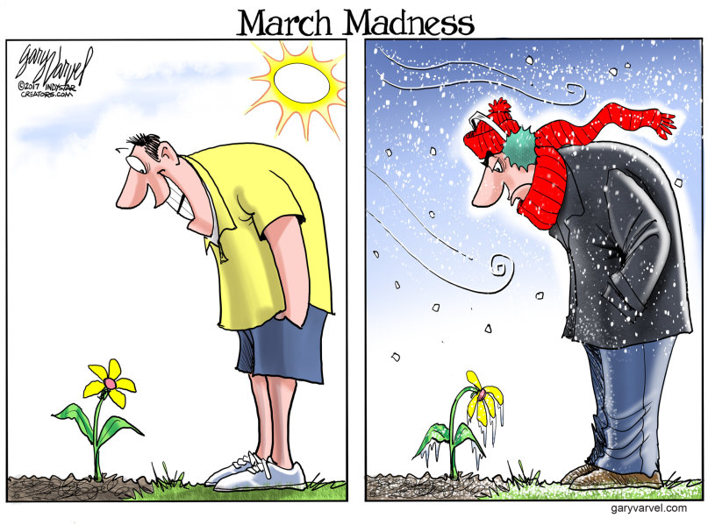

Slide 7
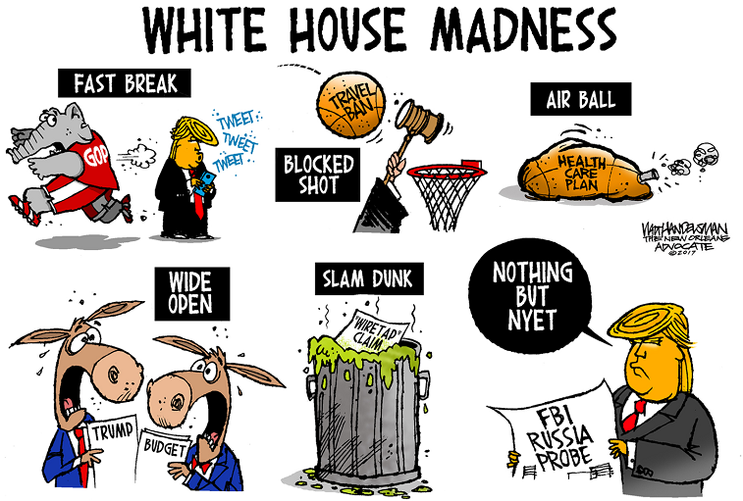

Slide 8
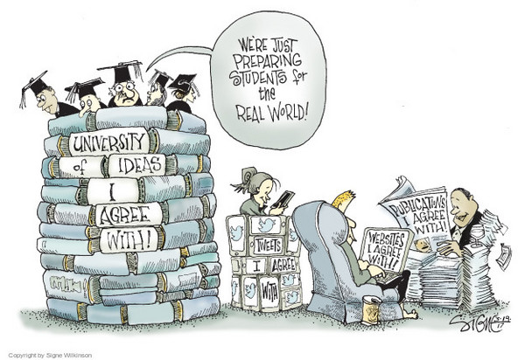

Slide 9
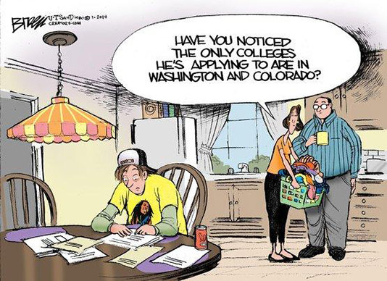

Slide 10
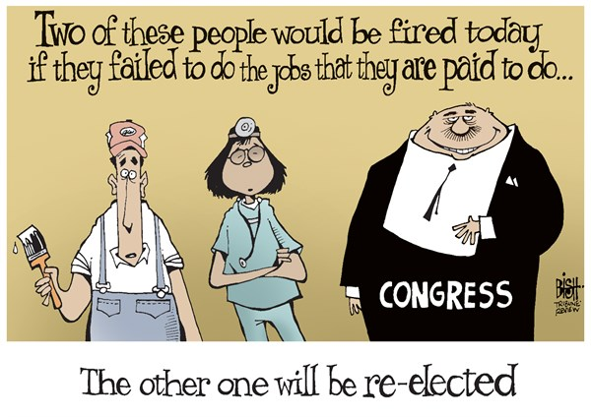

Slide 11
